Slide 1

TranzVolt 2.0
Survance | Jia | Jang | Bunner | baek | Yerramilli
Interdisciplinary capstone design | Dr. collins | Capstone team
Notes:
Solomon

Slide 2

THE Design Problem
Notes:
Solomon

Slide 3
Original tranzvolt
Notes:
Solomon

Slide 4
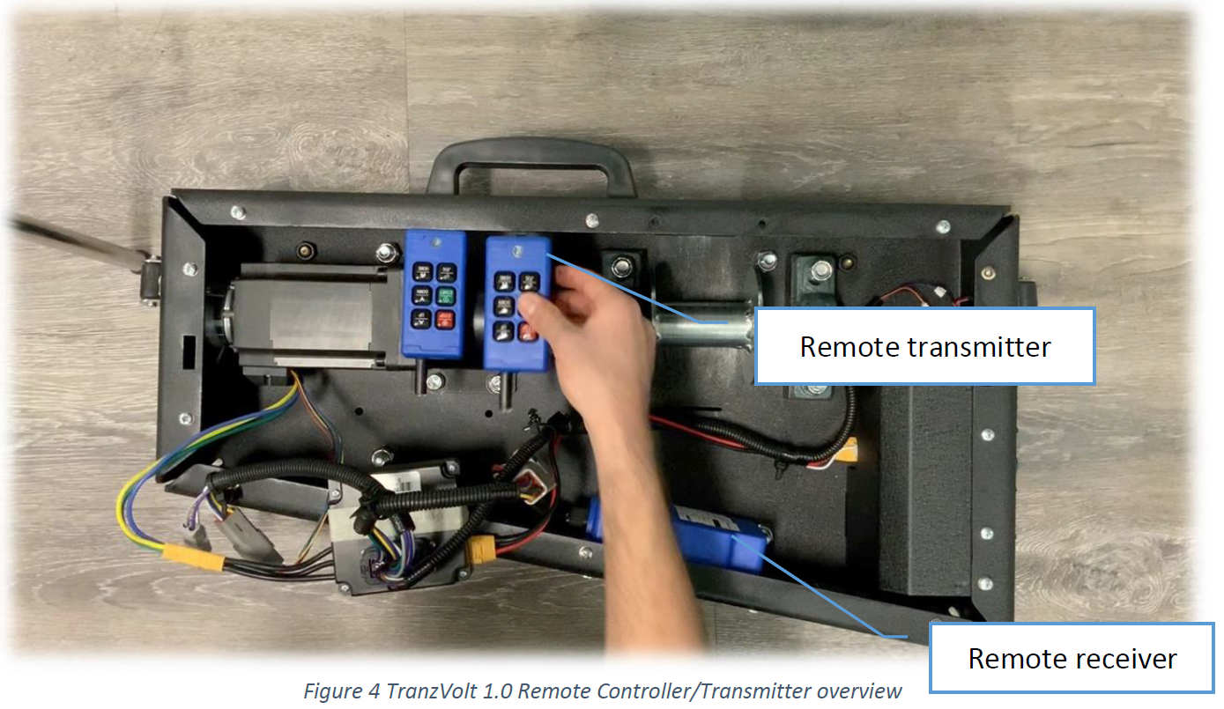
Project FOcus
Develop new motor box
Improved Battery Management System
Plug-in wired controller with new UI
Auto-homing mechanism
Bluetooth adaptable controls
Three Subsystems:
Battery Management System (BMS)
User Interface (Remote Controller)
Microcontroller Unit (MCU)
Current TranzVolt Motor Box
Notes:
Solomon + Ray

Slide 5
Battery management system (BMS)
Notes:
Ray

Slide 6

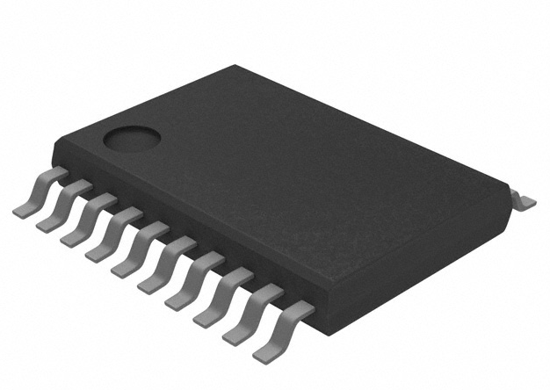
BMS Design
Batteries:
2x 20V MAX XR Premium Lithium-Ion 5.0Ah Battery Packs
Existing Problems:
Only safety mechanism – Thermal Sensor
New system: TI BQ77904 IC
Voltage Protection
Overcurrent Protection
DeWalt 20V Premium Lithium-Ion Batteries
Texas Instruments BQ77904 IC
Notes:
Ray

Slide 7
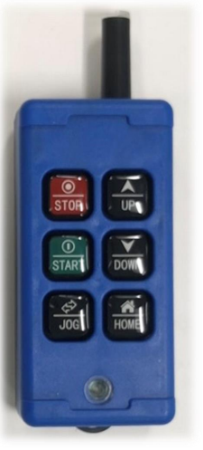
User Interface (remote controller)
Notes:
Solomon

Slide 8
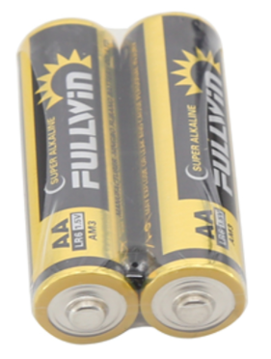
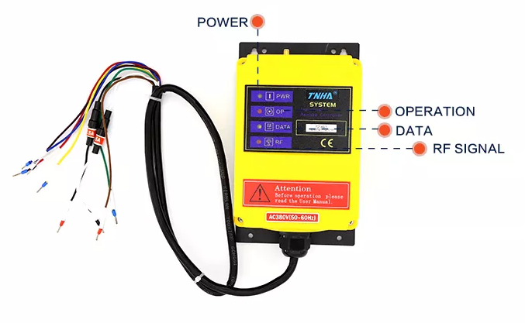
CURRENT REMOTE CONTROLLER ISSUES
Complexity of Interface
Receiver Redundancy
Battery Dependency
STOP
UP
START
DOWN
JOG
HOME
Notes:
Solomon

Slide 9
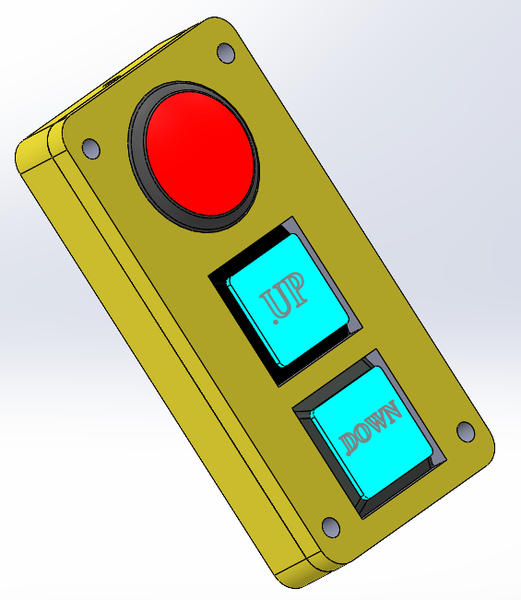
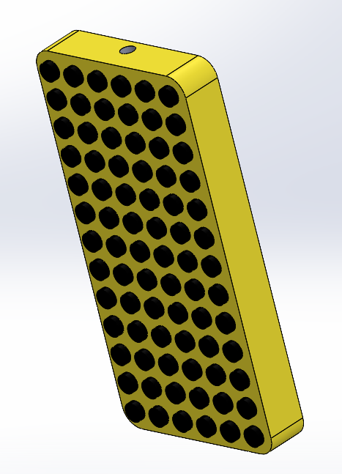
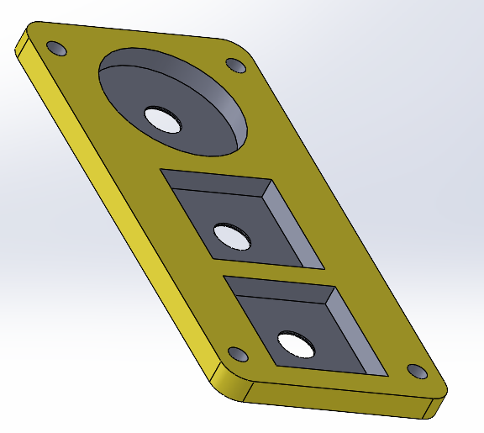
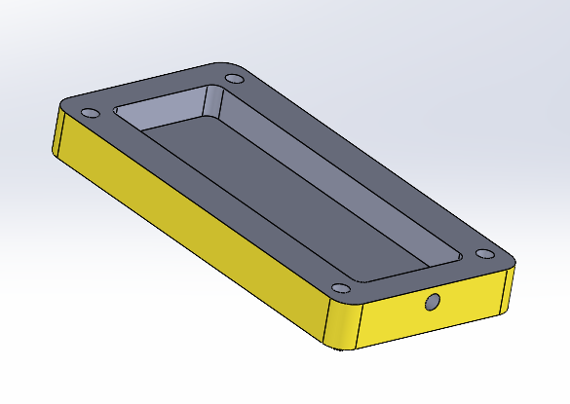
CURRENT TEAM DESIGN
3 buttons
Hole for wires on top
Two-part case, drilled together using screws
Outer case to be 3D printed
Notes:
Solomon

Slide 10
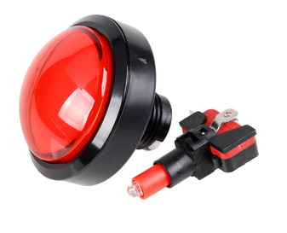
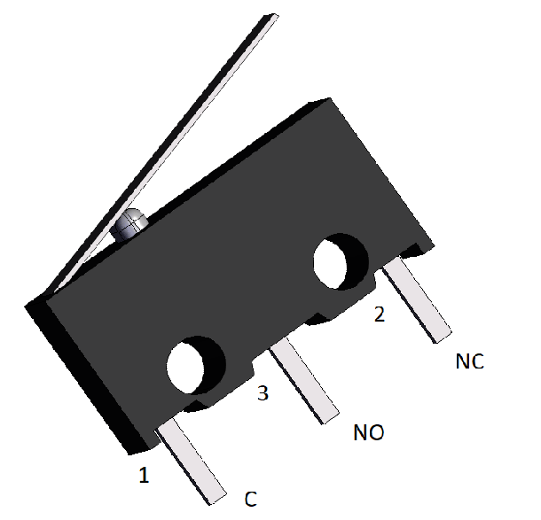
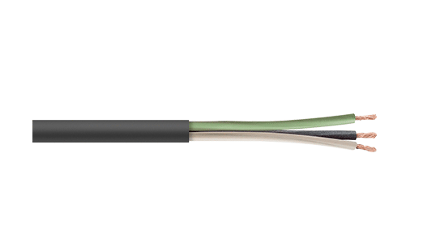
Components
Push Buttons
Electrical Cables
Notes:
Ray

Slide 11
Microcontroller unit (MCU)
Notes:
Ray

Slide 12
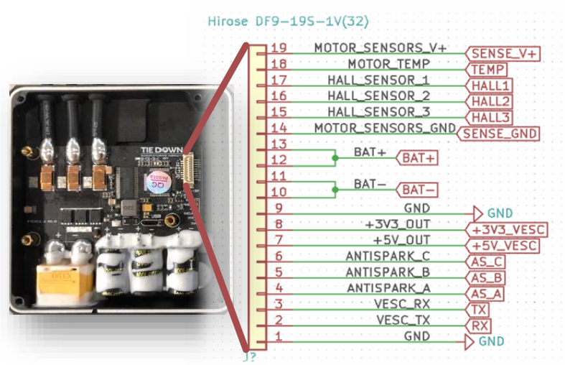
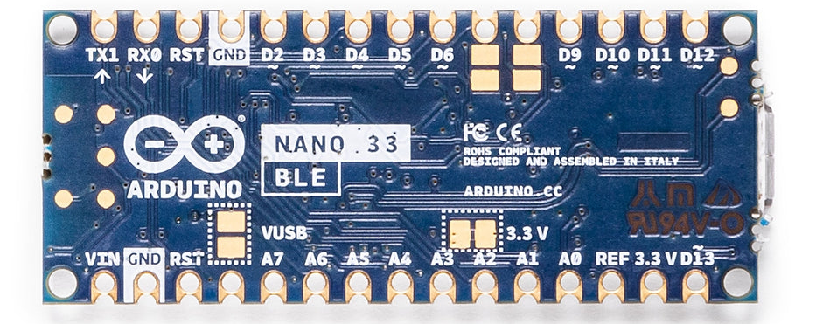
MCU Design
Existing: Icarus Control Unit (ICU)
No BLE
New: Arduino Nano 33 BLE
Bluetooth capability
Logic interface with UI system
UART interface with motor controller
Looking Ahead:
Homing System
Flipsky Motor Controller Overview and Pinout
Arduino Nano 33 BLE
Notes:
Ray

Slide 13
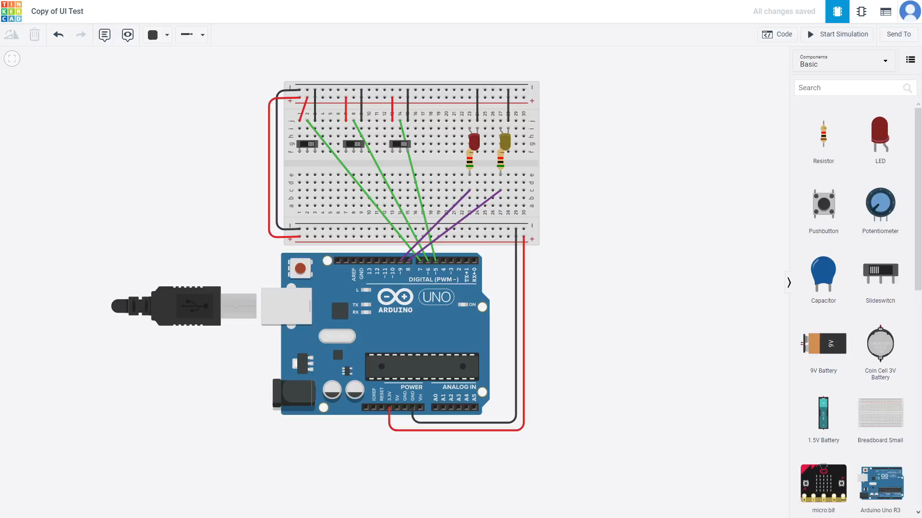
MCU TinkerCAD SImulation
YouTube Link
Notes:
Ray

Slide 14
Future work
Notes:
Solomon

Slide 15
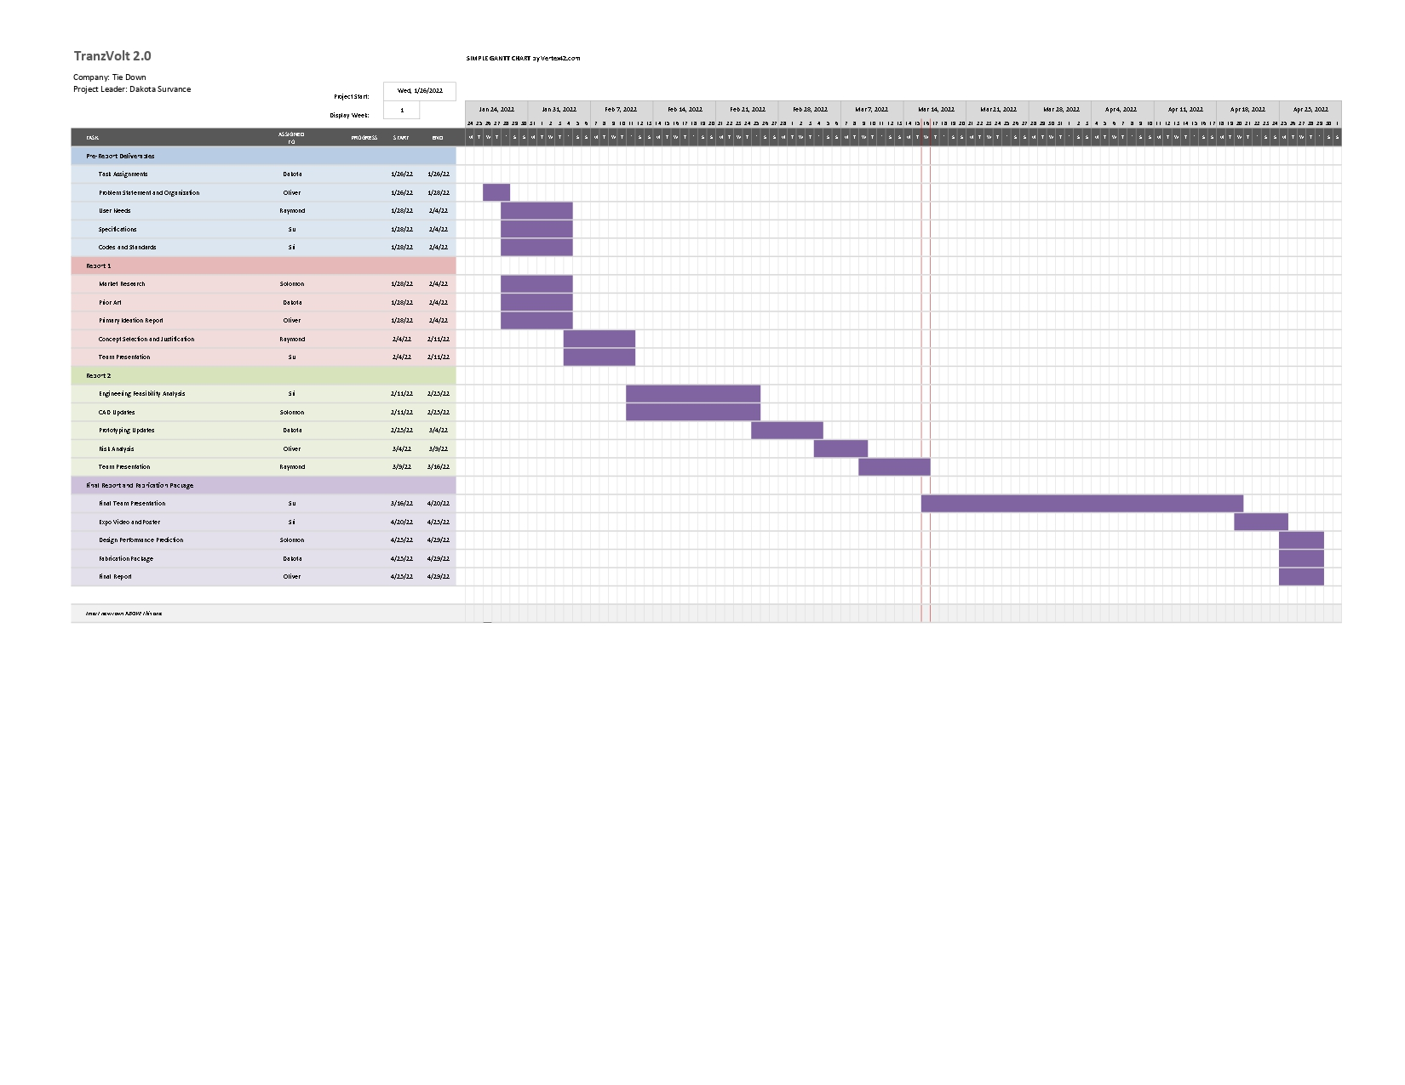
Future work
Notes:
Solomon

Slide 16

Thank You

